Slide 1

Keffie Token
Ryan Keen

Slide 2
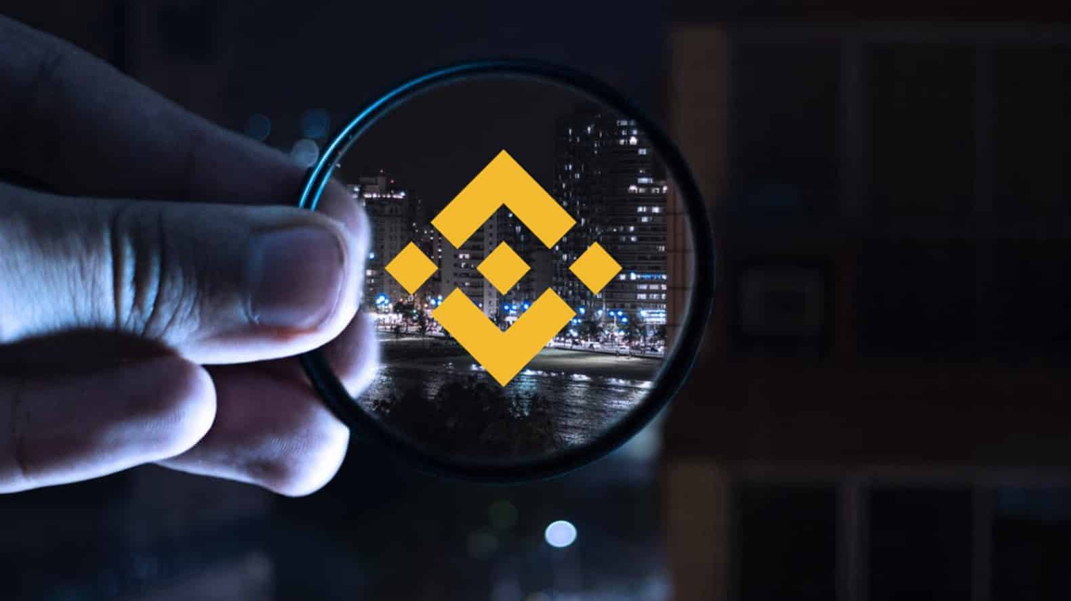


Introduction
Cats have taken over the world and created their own payment system to barter their goods. They have banded together to change the world for the better and have built a new and disruptive platform called the "Keffie Token". Keffie is a token that its kittens can use to transact with one another and also be used as a form of payment. In this Project, I completed the code that enables their Kiti-zens to send cryptocurrency payments to one another. To develop the code and test it out, I have launched the Keffie Token on the Binance Test Network. I have also provided the Kiti-zens w/ access to the test network with a custom RPC & helped them make new wallets using Metamask. Now they can find another Kiti-zen who is using the Token to pay them for their work.

Slide 3
Timeline
Phase 1
Decide which chain to launch the Keffie Token
Phase 2
Create the logic behind the Keffie Token so its users can interact and transact with the blockchain of choice
Phase 3
Connect to the blockchain of choice using the custom RPC testnet to test the contract
Title
Launch the token on the testnet and check verification status of proper token deployment.

Slide 4
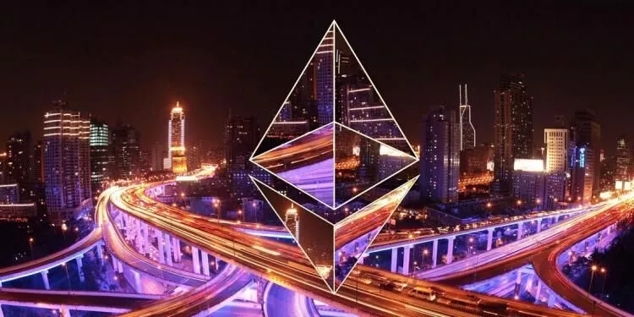
Solidity
The language used to create the smart contract is solidity.
Even though solidity is the well known smart contract language, I was able to use solidity to launch on different networks.
I decided to go with the Binance Smart Chain because the gas fees were cheaper
Oppenzeppline was also used to limit the security risk of deploying the smart contract.

Slide 5
Binance Smartchain

Slide 6
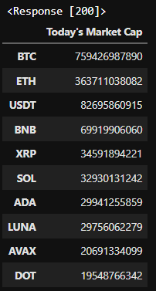
Table
BNB is 4th in market cap (but the 3rd overall crypto).
BNB’s fees are cheaper that Ethereum.
BNB is faster than Ethereum.

Slide 7
Token Construction

Slide 8



Contract DNA
3% fee auto add to the liquidity pool to locked forever when selling
2% fee auto distribute to all holders
KFT Token will deflate itself in supply w/every transaction & 50% of the supply is burnt from start

Slide 9
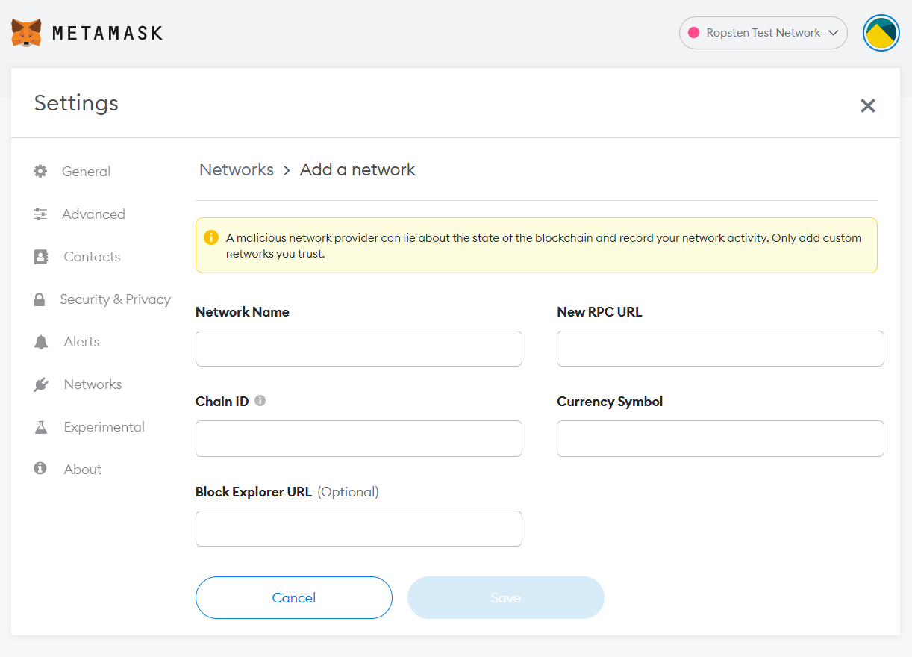
Binance Smart Chain RPC
Custom RPC Instructions
Network Name: BSC Testnet
New RPC URL : https://data-seed-prebsc-1-s1.binance.org:8545/ Currency Symbol : tBNB
Keffie Token Contract: 0xf0285718579DfF12A4353ABFedF5784ff0e61EBA
Testnet Faucet: https://testnet.binance.org/faucet-smart
Pancake Swap Testnet: https://pancake.kiemtienonline360.com/#/swap

Slide 10
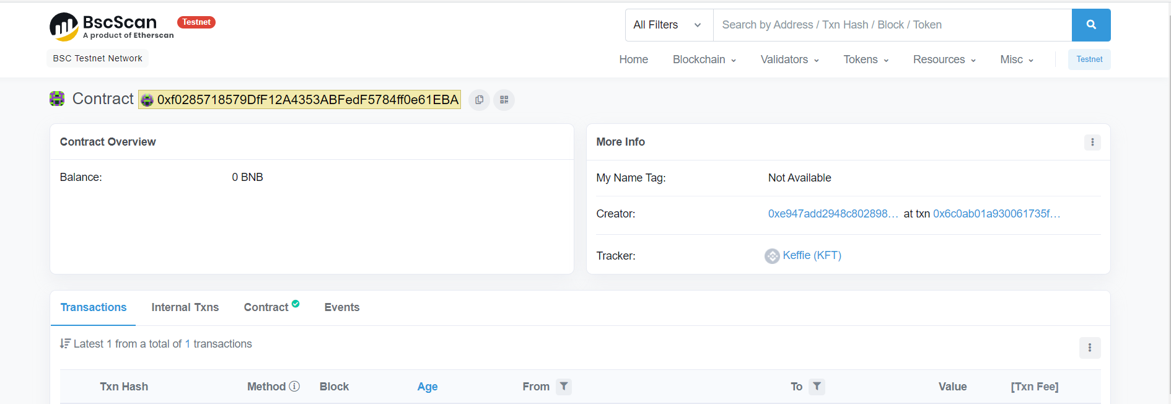
Smart Contract Testnet Deployment

Slide 11
Thank You
Ryan Keen
rlkeen94@gmail.com
Urbandigitalassets.xyz

